Slide 1
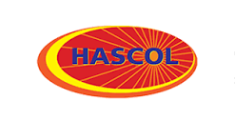
Hascol petroleum
Group members
ANAS ABID
FURQAN HAMEED
AHMED ALI KHAN

Slide 2
Introduction
Hascol was granted omc license in 2005
Went public in 2014 on psx
15 AUTOMAX LPG STATIONS ACROSS PAKISTAN
VITOL, LARGEST OIL TRADING ENTITTY OF WORLD ACQUIRED 15% OF SHARES OF HASCOL IN 2016
LAUCHED LPG MARKETING COMPANY VAS LNG LMT AS JOINT VENTURE WITH VITOL
ANOTHER JOINT VENTURE WITH VITOL, Hascol Terminals Limited (HTL) constructed Petroleum terminal at bin qasim port with capacity of 197000 metric tons
LUBRICANT PLANT HAS ALSO BEEN CONSTRUCTED AT BIN QASIM PORT IN 2019.

Slide 3
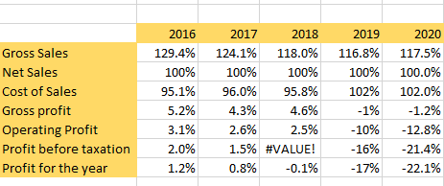
Income statement-common size analysis

Slide 4
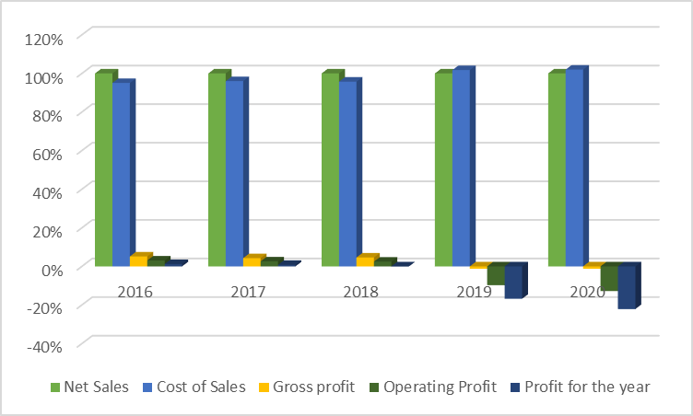
Graphical analysis of is-common size

Slide 5
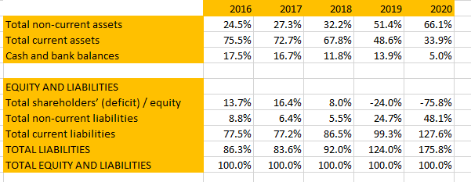
Balance sheet-common size

Slide 6
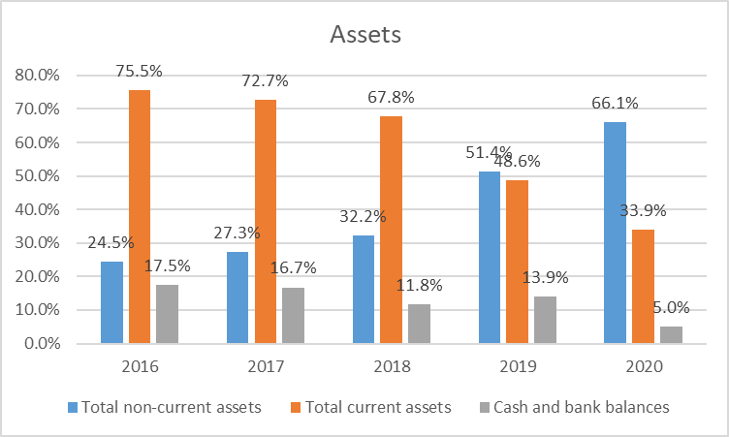
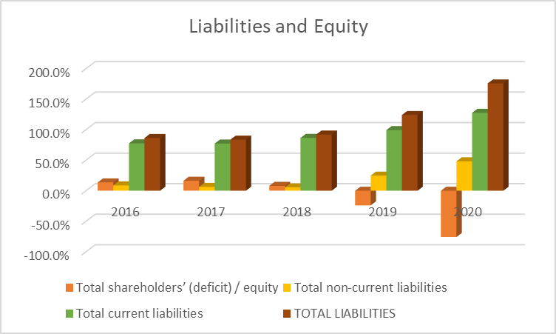
BALANCE SHEET-COMMON SIZE

Slide 7
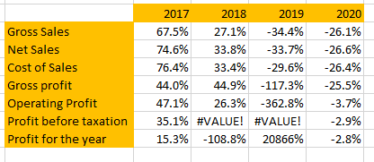
TREND ANALYSIS-INCOME STATEMENT

Slide 8
TREND ANALYSIS-INCOME STATEMENT

Slide 9
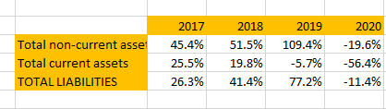
TREND ANALYSIS-BALANCE SHEET

Slide 10
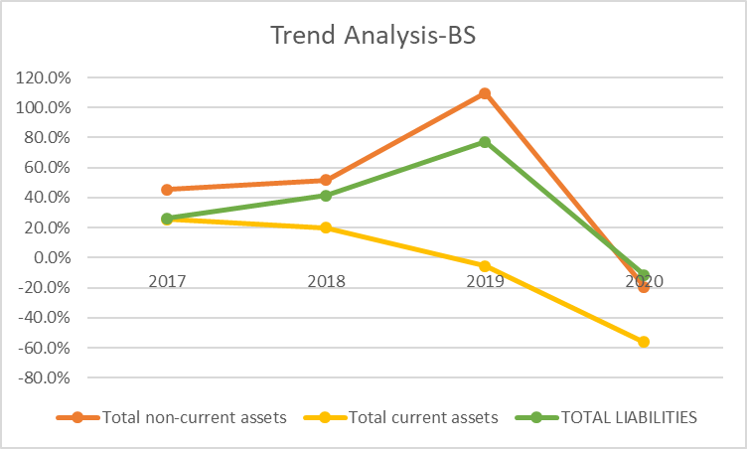
TREND ANALYSIS-BALANCE SHEET

Slide 11
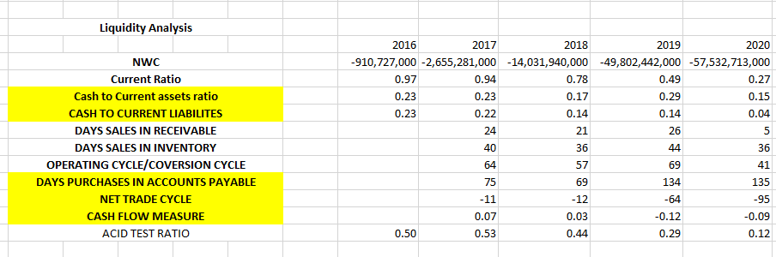
LIQUIDITY ANALYSIS

Slide 12
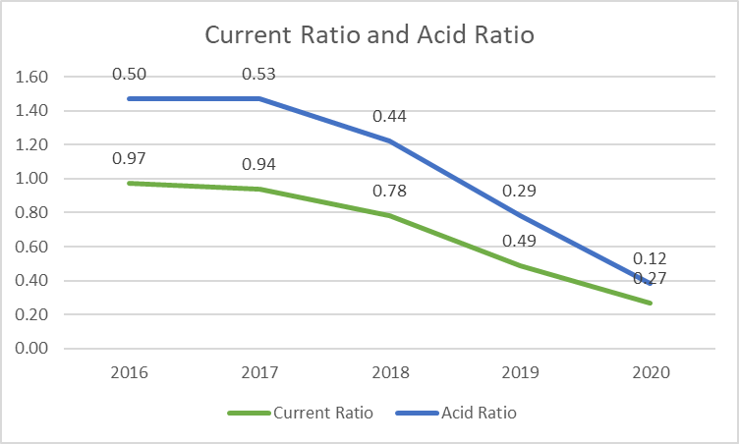
LIQUIDITY ANALYSIS

Slide 13
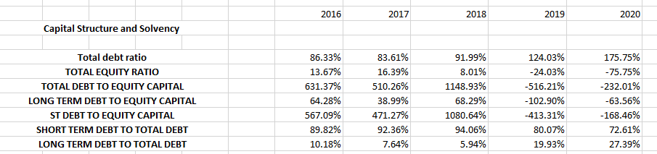
CAPITAL STRUCTURE AND SOLVENCY

Slide 14
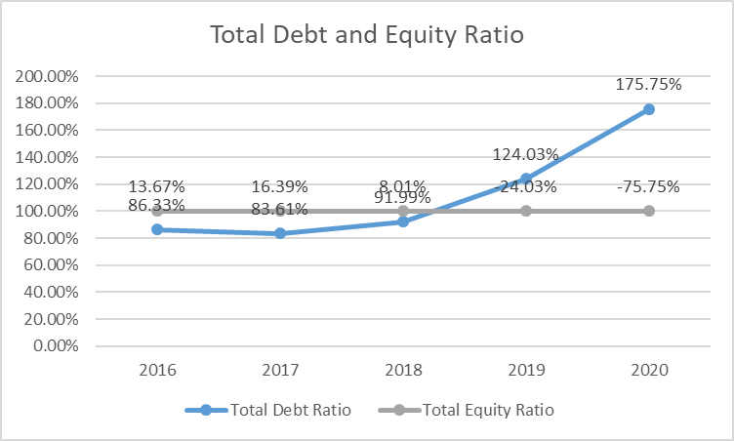
CAPITAL STRUCTURE AND SOLVENCY

Slide 15
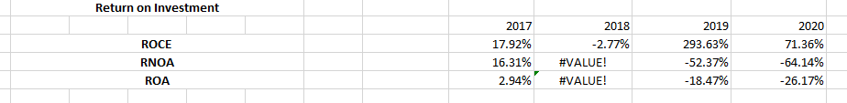
ROIC ANALYSIS

Slide 16
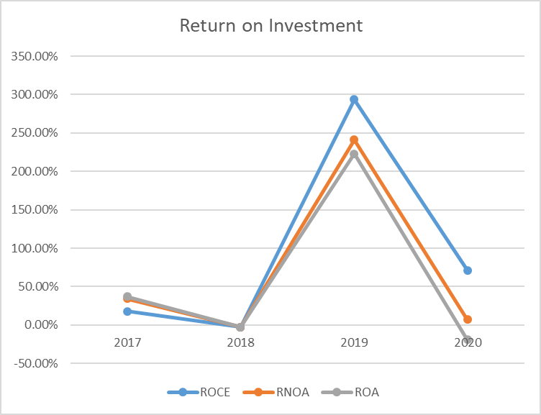
ROIC ANALYSIS

Slide 17
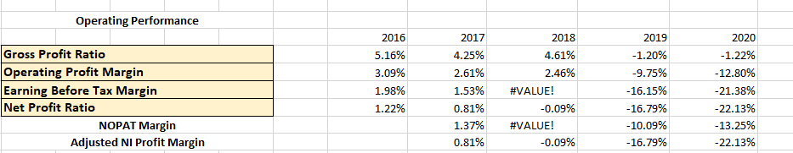
OPERATING MEASURES

Slide 18
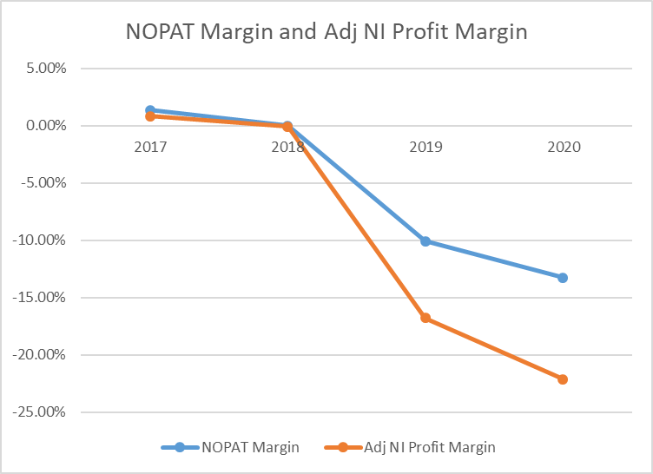
OPERATING MEASURES

Slide 19
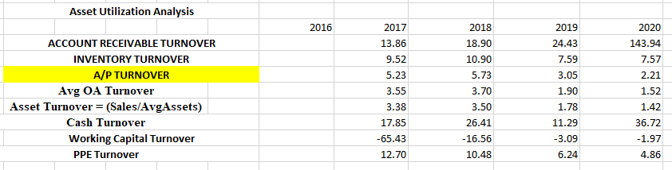
ASSET UTILIZATION ANALYSIS

Slide 20
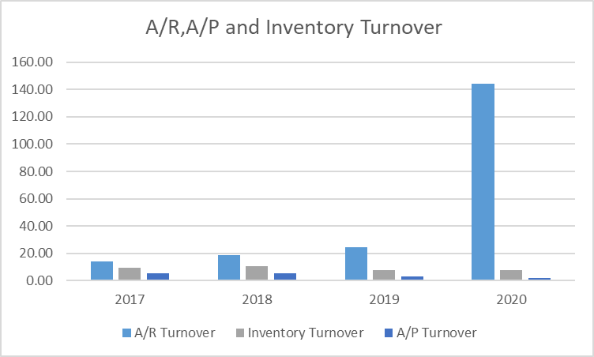
ASSET UTILIZATION ANALYSIS

Slide 21
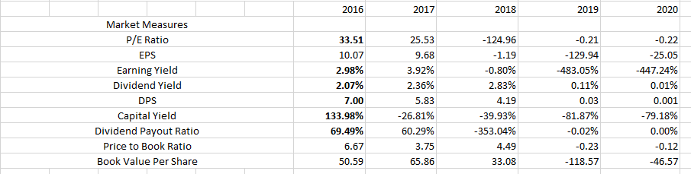
MARKET MEASURES

Slide 22
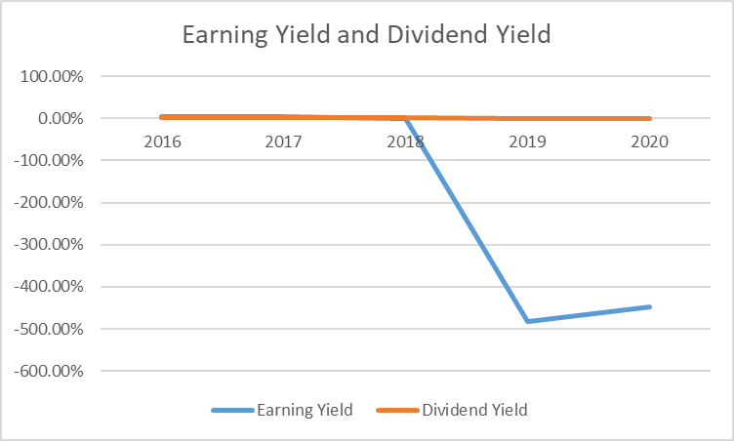
MARKET MEASURES

Slide 23
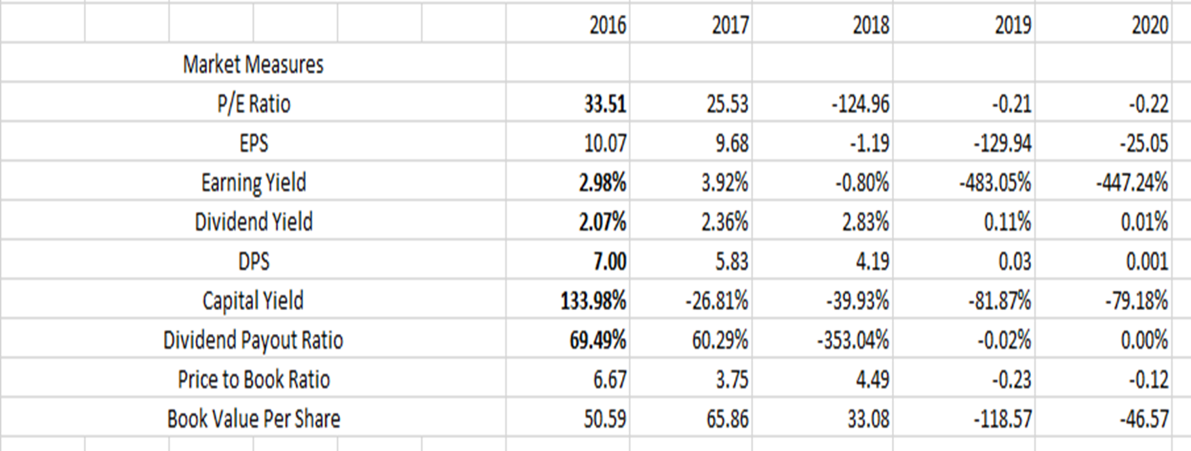
TAKE ON FIRM AS INVESTOR

Slide 24

TAKE ON FIRM AS CREDITOR

Slide 25
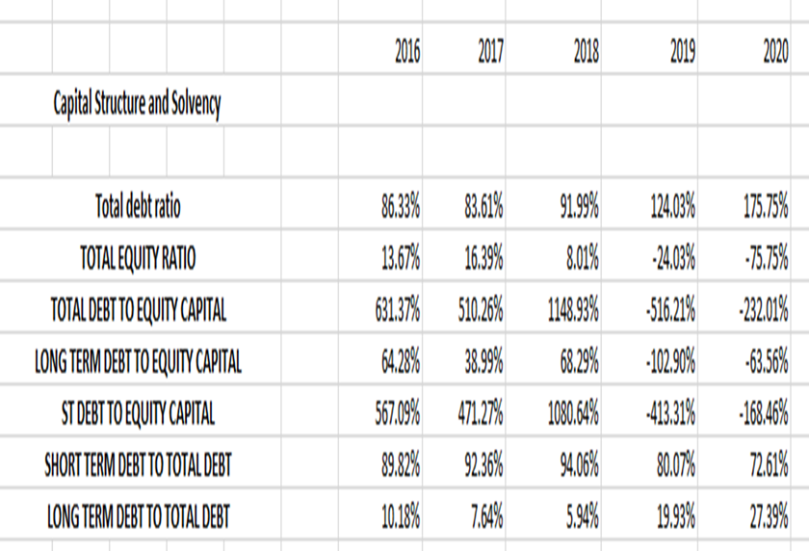
TAKE ON FIRM AS CREDITOR

Slide 26
SUGGESTIONS TO FIRM
Try to eliminate losses and earn back profits
Increase Current assets to MEET SHORT TERM OBLIGATIONS
IMPROVE RETURN MEASURES
CHANGE CAPITAL STRUCTURE AS 86% DEBT AND 14% EQUITY CAN LEAD TO DEFAULT AND TRY TO INCREASE EQUITY.

